Slide 1
Dynamic Thermalization
Boris Fine
Nazarbayev University, Astana, Kazakhstan

Slide 2
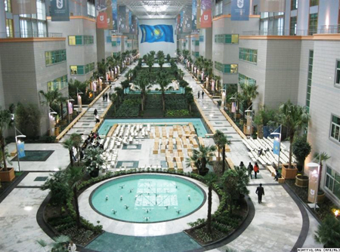
Kazakhstan
Astana
Nazarbayev University

Slide 3
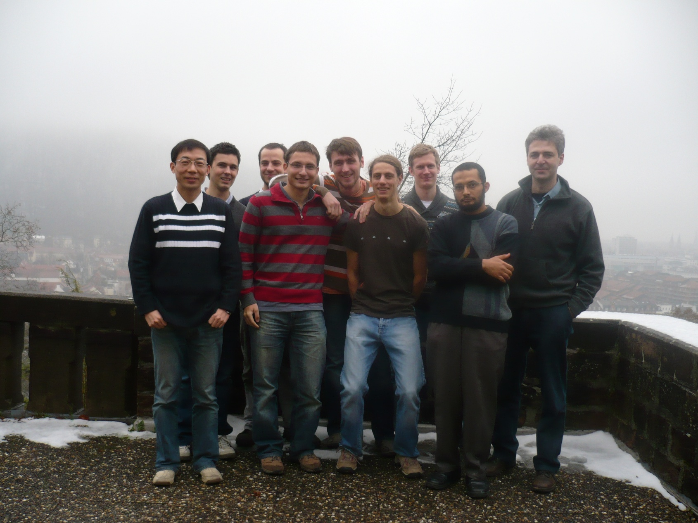
Group - Quantum Dynamics and Complex Quantum Systems, ITP Heidelberg
Front row: Kai Ji, Frank Hantschel, Chahan Kropf, Tarek Elsayed
Back row: Gerit Brandenburg, Ben Hess, Walter Hahn, Fabian Kolley, Boris Fine

Slide 4
thermodynamics = thermal properties of macroscopic objects
microscopic foundation of thermodynamics = statistical mechanics
dynamic foundations of statistical mechanics
The question of dynamic thermalization:
What kind of statistical behavior emerges dynamically under realistic
manipulations with thermally isolated many-particle systems?
Do many particle systems always evolve to equilibrium?
How do they evolve to equilibrium?

Slide 5
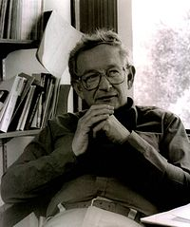
Is statistical mechanics a fundamental branch of physics?
“The ability to reduce everything to simple fundamental
laws does not imply the ability to start from those laws
and reconstruct the universe.”
P.W. Anderson, More is different, Science 177, 393 (1972)

Slide 6
Why dynamic thermalization?
1. Understanding the applicability limits of equilibrium statistical physics.
Exploring nonequilibrium physics: nanosystems, biosystems, etc.
2. Extracting new microscopic information from experiments.
Solving nonperturbative many-particle problems.
3. Exploring the fundamental limits of underlying microscopic laws.
In particular, quantum-to-classical transition.
4. New experimental possibilities in recent years.
Controlling dynamic thermalization for engineering purposes.
5. Interesting mathematics: ergodicity, chaos, etc.

Slide 7
Plan of this course:
Day 1: Review of dynamic foundations of statistical physics.
Day 2: Dynamic thermalization and chaos in classical systems.
Day 3: Notion of chaos in quantum systems and its relevance to
the thermalization problem.
Day 4: Dynamics of classical and quantum systems in the regime
of small deviations from equlibrium.
Day 5: Statistical ensembles emerging in driven quantum systems.

Slide 8
Timeline:
1600… Early works by Torricelli, Pascal, Boyle, Mariotte, Hook, Fahrenheit
Stahl introduces the idea of phlogiston.
Savery invents first heat engine
1700… Benoulli, Lomonosov, Black, Lavoissier, Rumford, Dalton
Initial proposals of molecular models of heat
1800… Fourier, Avogadro, Carnot, Meyer, Joule, Kelvin, Clausius,
Maxwell, Boltzmann, Gibbs
1st and 2nd laws of Thermodynamics.
Entropy and its atomistic interpretation. Notion of molecular chaos.
1900… Planck, Einstein, Nyquist, Onsager, Callen/Welton, von Neumann,
Wigner, Bogoliubov, Anderson, Landauer
Quantum thermodynamics, fluctuation-dissipation relations, localization,
relation between information and thermodynamics
Poincare, Lyapunov, Kolmogorov et al., Krylov: chaos
Several modern-day schools of statistical physics

Slide 9
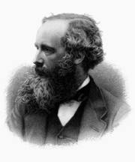
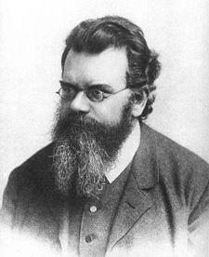
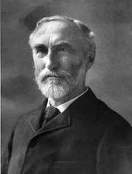
Boltzmann-Gibbs distribution:
Basis of all
statistical physics
J. C. Maxwell
L.E. Boltzmann
J. W. Gibbs
Notes:
Summary of the results here!

Slide 10
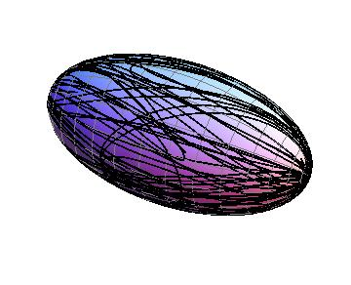
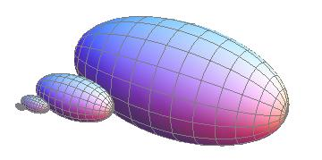
Classical derivation of Boltzmann-Gibbs distribution
Energy shell in the phase space
ergodically covered by a
chaotic phase space trajectory
The volume of the energy shell grows
exponentially fast with energy:
Notes:
Summary of the results here!

Slide 11
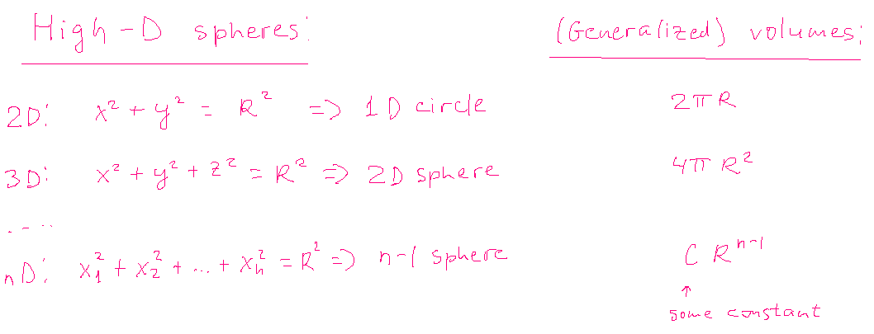
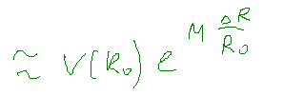
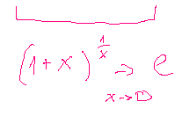
Examples of high-dimensional surfaces:

Slide 12
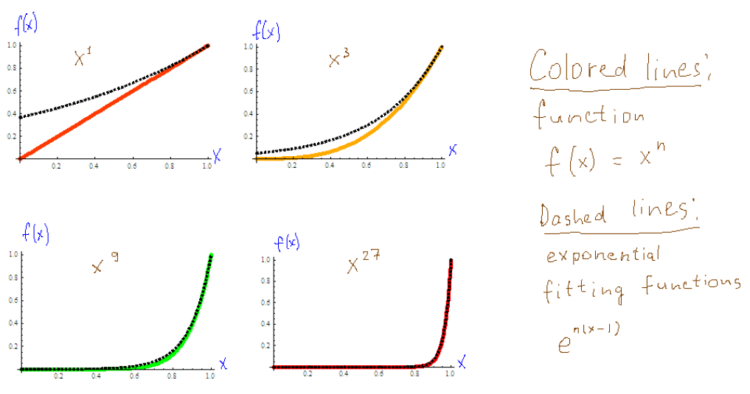

Slide 14
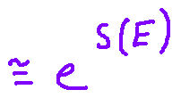
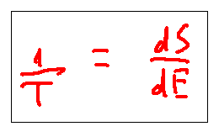
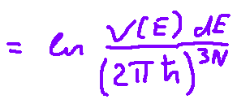

Slide 15
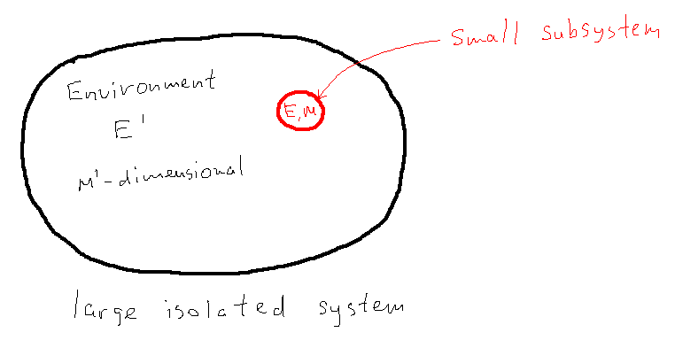
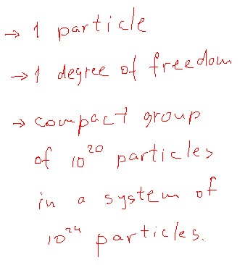
Boltzmann-Gibbs
distribution

Slide 16
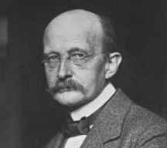
Quantum statistical mechanics
Boltzmann-Gibbs
distribution works
perfectly well
M. Planck
ћ ?
Heisenberg uncertainty principle?
Quantum superpositions?
Energy shell in
the phase space
Notes:
Summary of the results here!

Slide 17
Boltzmann-Gibbs distribution for quantum systems:
the microcanonical ensemble
Eigenfunction of the total system
_{total} = _{subsystem} _{environment}
E_{total} = E_{subsystem} + E_{environment}
0
E_{subsystem}
_{e}(E)
Around E = 0
_{e}(E)  _{e}(0) e ^{ E}
Micro-canonical postulate:
At a given energy E_{total} , all participating
eigenstates of the entire system fall
within a narrow energy window around
E_{total} .
0
E_{environment}
_{tot}(E)
P_{subsystem} (E) = _{e}(-E)
~ e ^{- E}
Boltzmann-Gibbs
E_{total}
0
Why?

Slide 18
Grand canonical distribution
e ^{-  E}  e ^{-  (E – Np )}
Statistics for the occupations of single particle states
Fermi-statistics
Bose-statistics
…
e ^{– 3} ^{ (E – )}
e ^{-  (E – )}
E
e ^{– 2  (E – )}
E
1
E
e ^{-  (E – )}
E
1

Slide 19
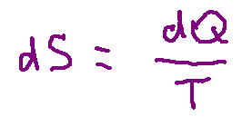
Dynamical issues in the foundations of statistical physics:
What does the 2nd law of thermodynamics tell us?
Different definitions of entropy:
The notion of time-dependent entropy?
Timescale for equilibration? Fast vs. intermediate vs. slow variables
Notion of macrostates. How can we be sure that we identified all
relevant slow macroscopic variables?
Issue of long-lived nonequilibrium states.
Gedanken experiment: solar-powered self-reproducing robots.
Apparent lack of equilibration on the global scale.

Slide 20
There is no doubt that the foregoing simple formulations [ of the law of increase of entropy] accord with reality; they are confirmed by our everyday observations. But when we consider more closely the problem of the physical nature and the origin of these laws …, substantial difficulties arise, which to some extent have not yet been overcome.
…
According to the results of statistics, the Universe [if regarded as closed system] ought to be in a state of complete statistical equilibrium. More precisely, any finite region of it, however large, should have finite relaxation time and should be in equilibrium. Everyday experience shows us, however, that the properties of Nature bear no resemblance to those of an equilibrium system; and the astronomical results show that the same is true throughout the vast region of the Universe accessible to our observations.
L.D. Landau and E. M. Lifshitz, Statistical Physics, part 1.

Slide 21
In this course:
Dynamic thermalization in systems with many equivalent simple parts and
short-range interactions.
Ergodicity hypothesis:
Every phase space trajectory visits every small part of the energy shell with
probability proportional to the volume of that part.
Zermello’s paradox:
Because of ergodicity, every nonequilibrium state will eventually reappear in
the system.
Resolution of Zermello’s paradox:
Time to wait for the spontaneous reappearance of macroscopic nonequilibrium
state is much longer than the estimated age of the Universe.

Slide 22
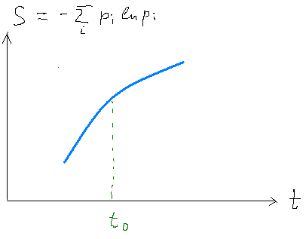
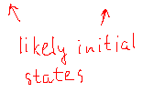
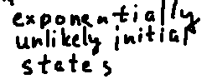
Time reversibility of microscopic dynamics vs.
time irreversibility of the 2nd law of thermodynamics:
Loschmidt’s paradox:
Reverse all momenta at t = t₀.
The probability of the resulting microstate is the
same as the probability of the original one, but it
will lead to the decrease of entropy.
Why does the entropy increase?
Resolution of Loschmidt’s paradox:
For a given value of entropy S₀, the most likely situation corresponds to S₀ being
near a minimum of S(t). Therefore, both the direct and the reversed time evolutions
lead to the increase of entropy.

